Slide 1
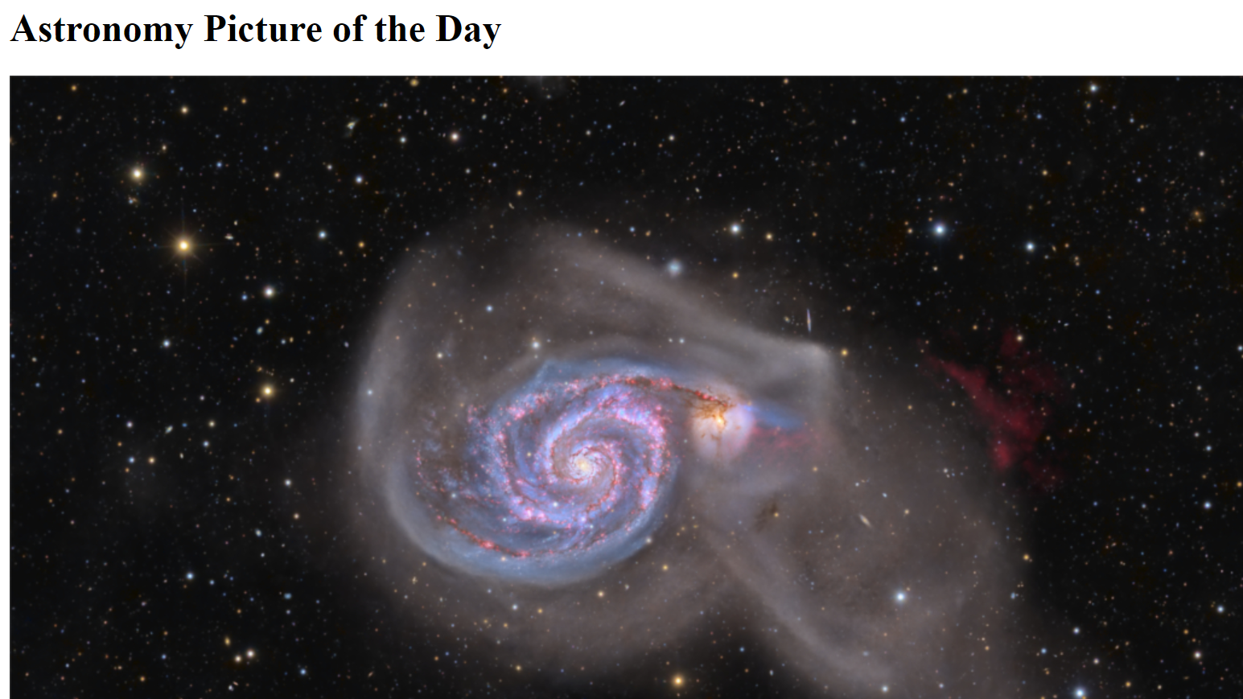
NASA APOD (Presentation)
Author Beenish

Slide 2
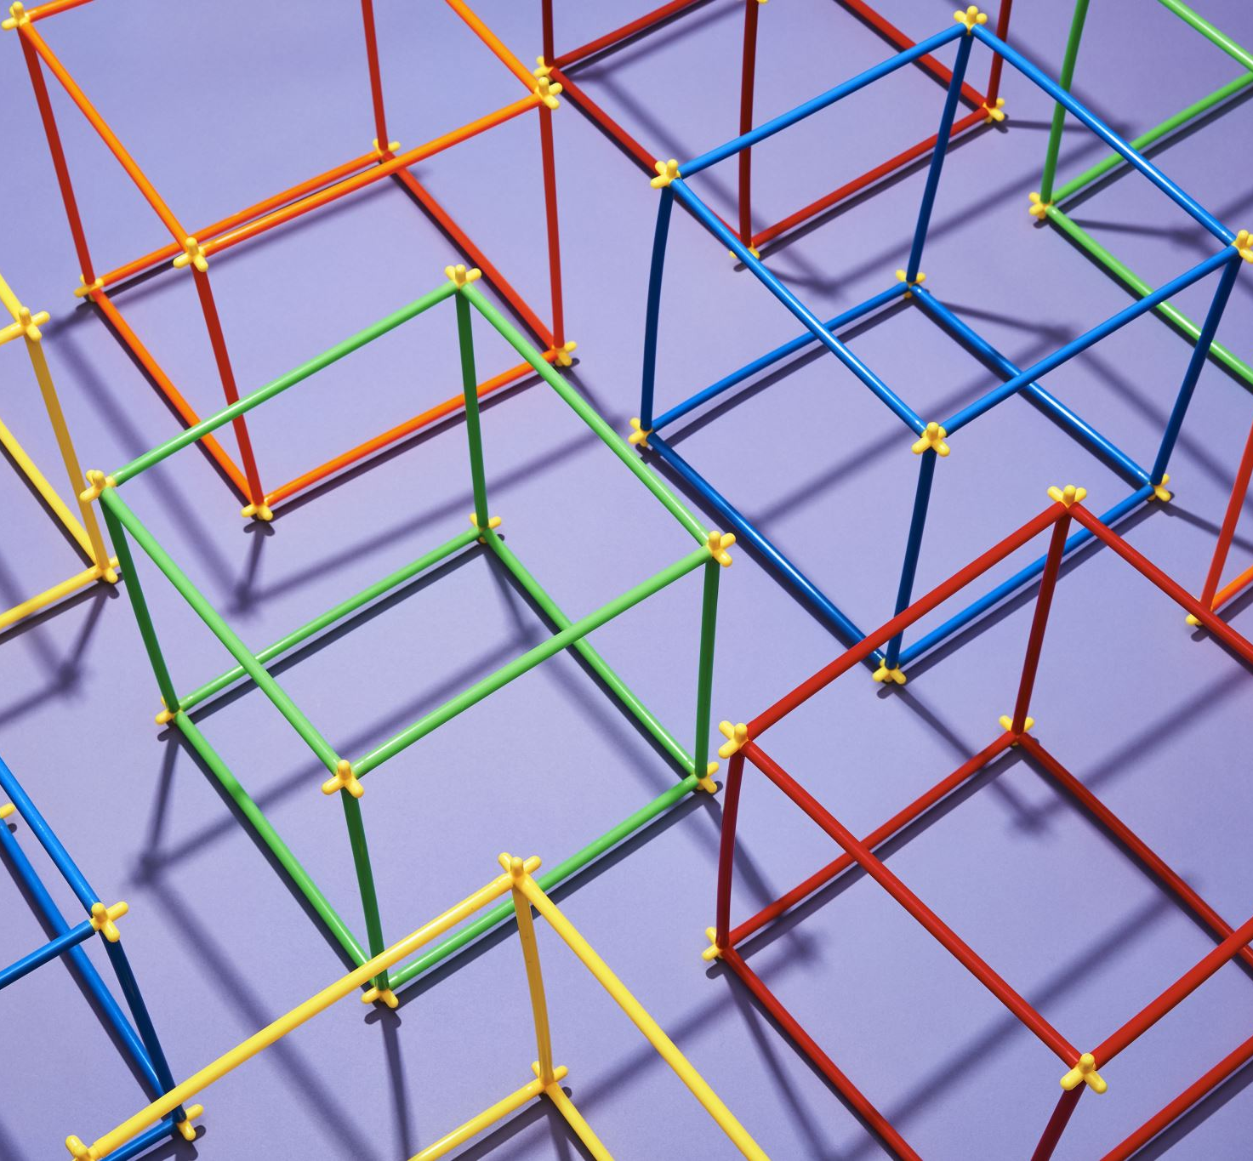
Agenda
Agenda
Overview
API Selection
Database Creation
Flask Connection (storing data in MongoDB)

Slide 3

Why Work on APOD
1. **Scientific Engagement:** Working on the NASA Astronomy Picture of the Day (APOD) project offers the unique opportunity to engage with space science and astronomy content. This project provides access to captivating images and explanations that highlight various celestial phenomena, allowing contributors to continuously explore and communicate the wonders of the universe to a wide audience.
2. **Educational Impact:** APOD is not just about showcasing stunning images; it's an educational platform that promotes science outreach and learning. The project has the potential to inspire and spark curiosity in individuals of all ages, fostering a deeper appreciation for space exploration.

Slide 4

The data process
Data Scraping and Analysis:
I created a Python script named apod_object_parser.py for scraping and analyzing data.
This script uses tools like Requests and Splinter to collect the latest Astronomy Picture of the Day and relevant information from NASA's APOD website.
Integration of NASA's APOD API:
I obtained an API key from NASA and integrated it into your application.
The application leverages NASA's APOD API to fetch dynamic and up-to-date data for the Astronomy Picture of the Day.
MongoDB and Flask Application:
The main application script, apod_spp2.py, combines MongoDB and Flask templating to create dynamic HTML pages.
You defined a function named scrape() within this script.
The scrape() function executes the scraping code and returns a Python dictionary containing the scraped data.
A Flask route /scrape imports apod_spp2.py and calls the scrape() function. The scraped data is then stored in a MongoDB database as a Python dictionary.
Another Flask route, the index route /, queries the MongoDB database to retrieve APOD data and sends it to an HTML template for rendering.

Slide 5

Cont..
HTML and User Interface:
The template HTML file, index.html, processes the APOD data dictionary received from the index route.
It dynamically displays the APOD image and its relevant information within the appropriate HTML elements.
This user interface provides users with an engaging and visually appealing representation of the Astronomy Picture of the Day, enriched with information about the universe.
Overall, this project demonstrates the seamless integration of various technologies, including web scraping, data storage with MongoDB, and web development with Flask and HTML. The result is an informative and visually captivating web application that keeps users updated with the latest captivating images and information from NASA's APOD API.

Slide 6
Beautiful Pictures from APOD

Slide 7
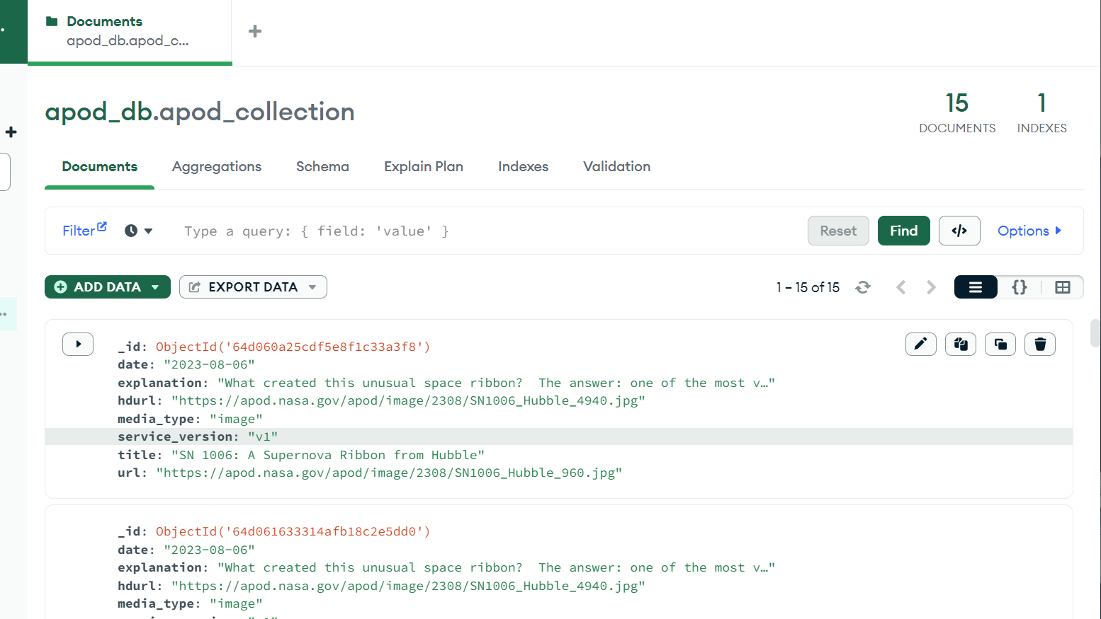
Screenshot of MongoDB storage

Slide 8
Lessons Learned from working on this project:
**API Integration and Key Management:**
Integrating external APIs, like NASA's APOD API, provides real-time and dynamic data to enhance your application.
**Web Scraping Techniques:**
I gained insights into web scraping techniques using tools like Requests and Splinter, which are valuable skills for extracting data from websites.
I Understood HTML structure and DOM traversal helps in effectively targeting and collecting specific data elements.
**Database Integration with MongoDB:**
Working with MongoDB introduced me to the concepts of NoSQL databases and document-oriented data storage.
Storing scraped data in MongoDB allows for easy retrieval of data, enhancing the overall user experience.
**Flask and Dynamic HTML Templating:**
Developing with Flask and using dynamic HTML templating allows you to create interactive and data-driven web applications.
Templating engines like Jinja2 facilitate the seamless integration of backend data into frontend HTML, enhancing user interaction.

Slide 9
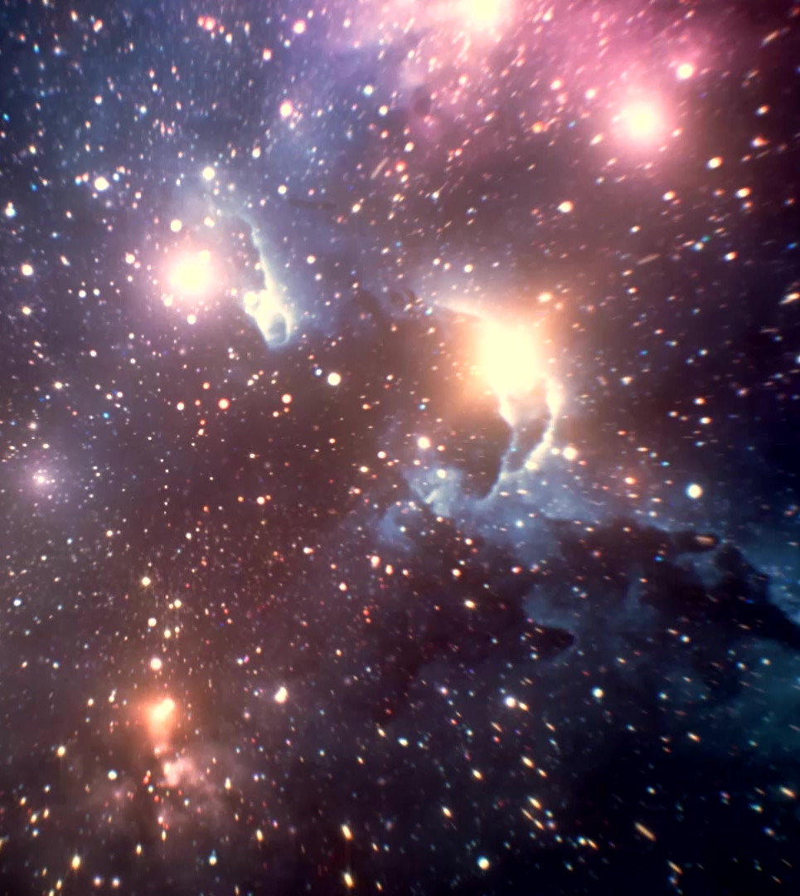
Thanks!
Thank you, NASA, for your incredible dedication to exploring the cosmos and sharing the wonders of our universe through initiatives like the APOD API. This project helped me learn a lot of concepts I am thankful

